Slide 1
Play your best card

Slide 2
Play your best card
Play Your Best Card is an interactive card game that prompts conversation and learning. It has been co-designed with teens, secondary school teachers and youth facilitators.
It raises awareness of organisations young people can contact when they need help.
It is a conversational card game that explores common issues young people might experience, and sparks critical thinking around problem solving.
It can be used in groups of three people or more, and has different ways of playing, to achieve different results.
Notes:
The game is designed to be played with between three and 15 players, but can be adapted to work with larger groups, or with the whole class in secondary schools. It can be used in any environment to provoke conversation and problem solving.
This resource provokes conversation around: AoD use, mental health, bereavement, bullying, relationships, sexual health.
The disrupter cards can be edited depending on the age of the group you are working with.

Slide 3
Notes:
Watch the video together

Slide 4
Facilitator role
Prepare
Set your group kawa
How do you want to set up your teams?
Consider your room setup
Consider the timing
Support the conversations to be supportive and open
Leave space to close the game
Consider giving the take-home resources.
Notes:
The following information can be found here: https://www.hpa.org.nz/sites/default/files/PYBC%20Facilitator%20Instructions_WEB%20ONLY.pdf
The facilitator might be the teacher, youth worker or professional leading the activity.
There are a few key things to do to help this game run smoothly, these include (talk through the below points)
Prepare for your session by seeking out best practice advice on the topics that you think may come up, or on topics that you intend to focus the session on. Read the facilitator, Scene Setter and Responder instructions.
Start by creating a safe and chilled-out space – begin with small talk, introductions, icebreakers and agreeing on some rules as a group to create a judgement-free space
Consider allowing young people to self-select teams – it may help them feel more comfortable to speak their minds. Consider the size of your group and how many people in each group, and how you want to structure the game to best suit the size.
If you’re in a classroom – think about how you might change the set up, so it feels more comfortable and less like a class, eg rearranging chairs into circles, moving the desks out of the way.
Think about timings for your game. For Scene Setters, give them a limit of between 2 and 5 minutes to create their story. For Responders, allow a similar amount of time to consider their response. You will need about ten minutes for the entire game, and longer if you want more in depth conversation.
During the game, actively facilitate through questions, discussion and reinforcing the need to respect each other’s opinions, to create sensible, safe and engaging conversations that bring an emotional understanding to the game (see some of the suggested prompts). While the scene setters and responders are considering what they will say, actively rotate through the people and groups and prompt conversation and ideas.
Make sure you give the time to do a proper closing after the game. Ask them talk about how they’ve felt, what they’ve learnt and what they’ll take away.
You may wish to explore some of the additional questions and take-home pamphlet to help encourage young people to think what they’ve learnt from the game.

Slide 5
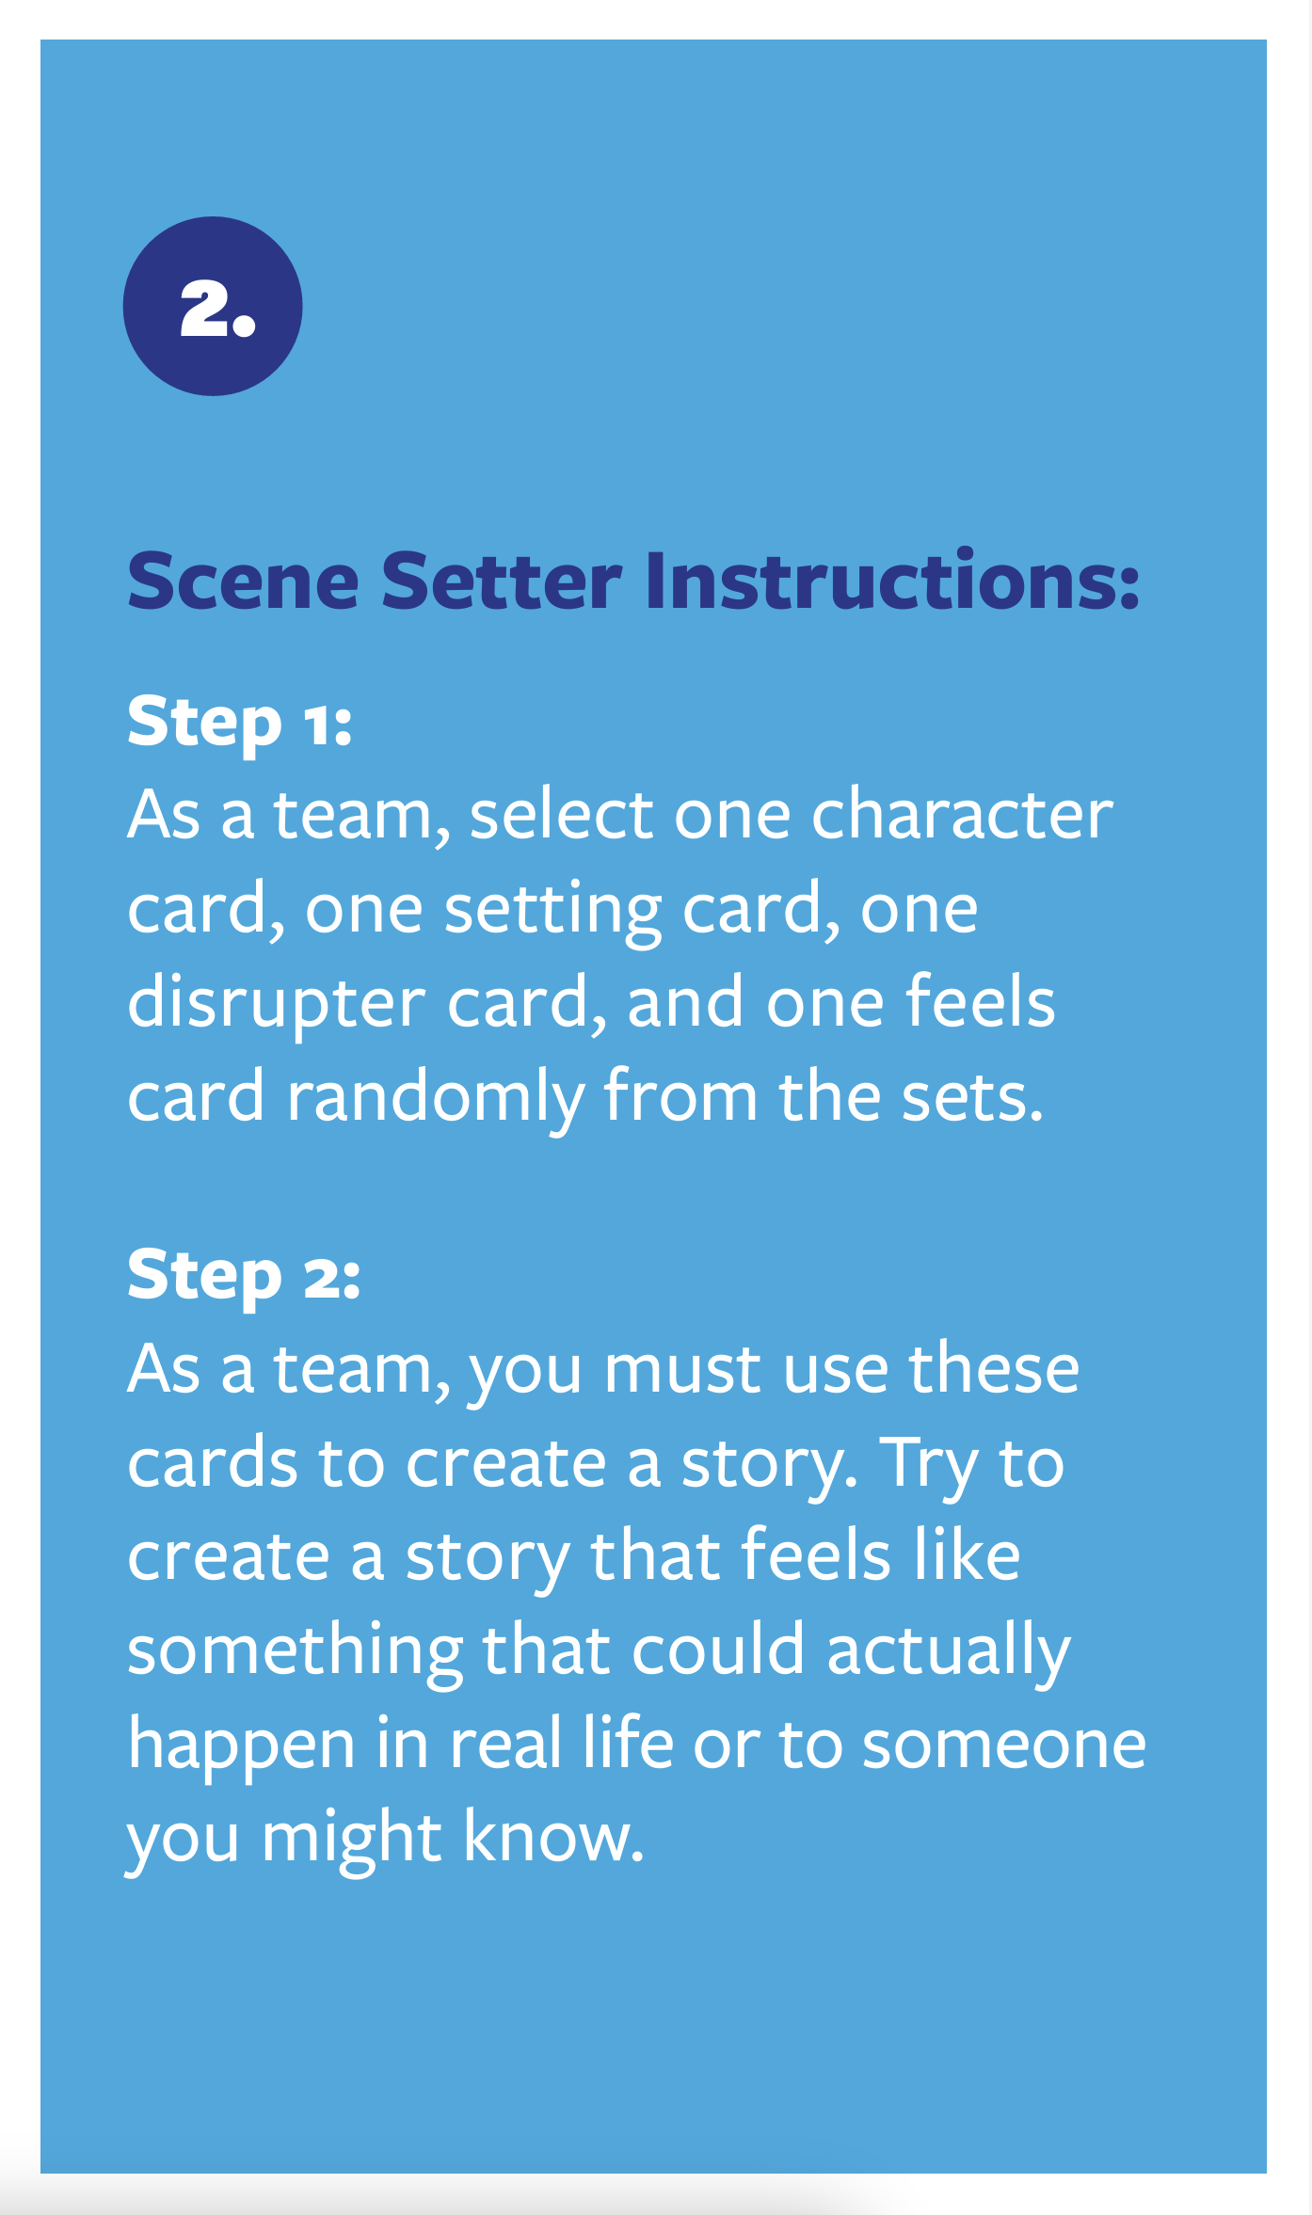
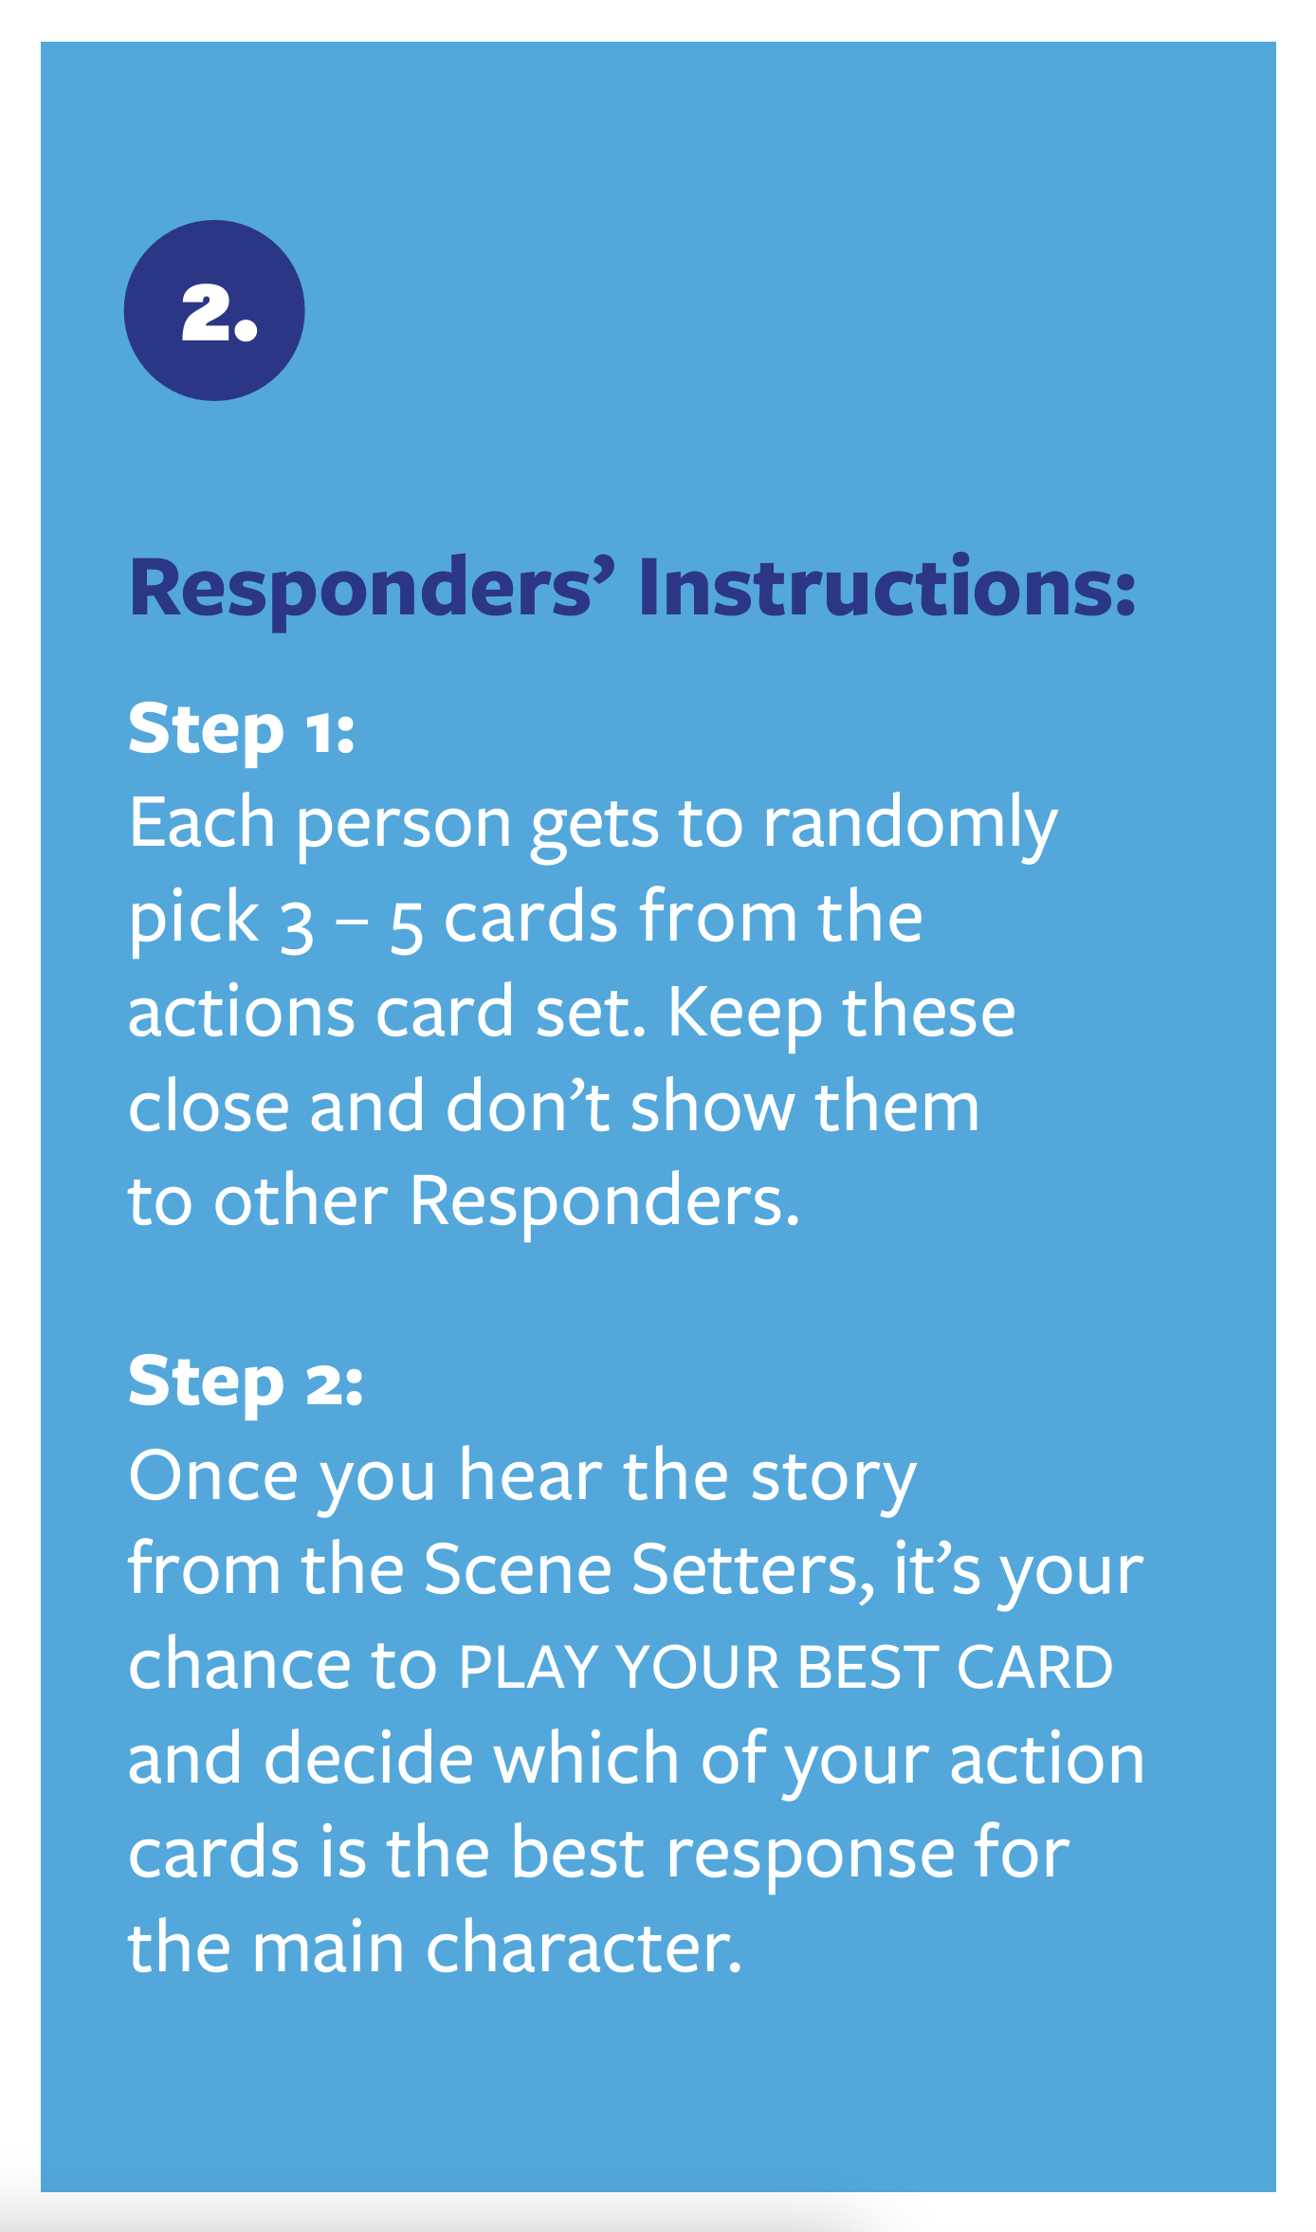
Let’s play
Notes:
This is an example of a script only:
To play this game we’re going to use the PLAY YOUR BEST CARD set to create stories about things that could happen in real life to other young people like you. I need one group of scene setters (approx. 1-5 people) and the rest will be responders.
Scene setters: One team will be the Scene Setters. You will be the story creators and have a character card, setting card, disrupter card and feels card to help you create the story together. You will have up to 5 minutes to work together to make your story before you have to present it to the other team. Give the ‘scene setter’ instructions to the group and explain how to build a story using the information they have, encourage creating situations that feel real to them with detail that adds to the story. More information here: https://www.hpa.org.nz/sites/default/files/PYBC%20Scene%20Setters%27%20Instructions_web.pdf
Responders: You will each get to randomly pick 3 to 4 actions. Once you’ve heard the story, you will get 3 minutes to decide what would be the best response for the main character in the story. Responders compete against eachother to win the round and the scene setters act as a panel to decide who wins. Give the responder instructions to each responder and make sure each person knows what to do. More information found here https://www.hpa.org.nz/sites/default/files/PYBC%20Responder%20Instructions_web.pdf
You will present your response to the Scene Setters with your reasons for choosing that action. Scene Setters – you’ll get 1 minute to deliberate and decide which Responder chose the best action to take. Whoever is chosen wins the round! It’s important to remember that there are a range of settings and scenarios that can be created. This is a chance for you to explore situations you may not have been in before and what you would do and how you would feel if you were there.

Slide 6
After each round
The conversation during and after the game is central to build critical thinking.
Some helpful prompts after each game is played are:
How would you respond in real life?
What were the important parts in your decision making?
Why did you choose that action as a response?
How did you feel when you were trying to think of the best action to take?

Slide 7
Adapting the game
The game is designed to be played with between 3 and 15 players, but can be adapted to work with larger groups, and with the whole class.
Lots of ideas for adapting this game can be found here
Notes:
More ideas can be found here: https://www.hpa.org.nz/sites/default/files/3.0%20MH131%20PYBC%20Ways%20to%20Play%20Info%20Sheet.pdf

Slide 8
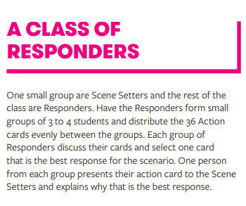
Variation

Slide 9
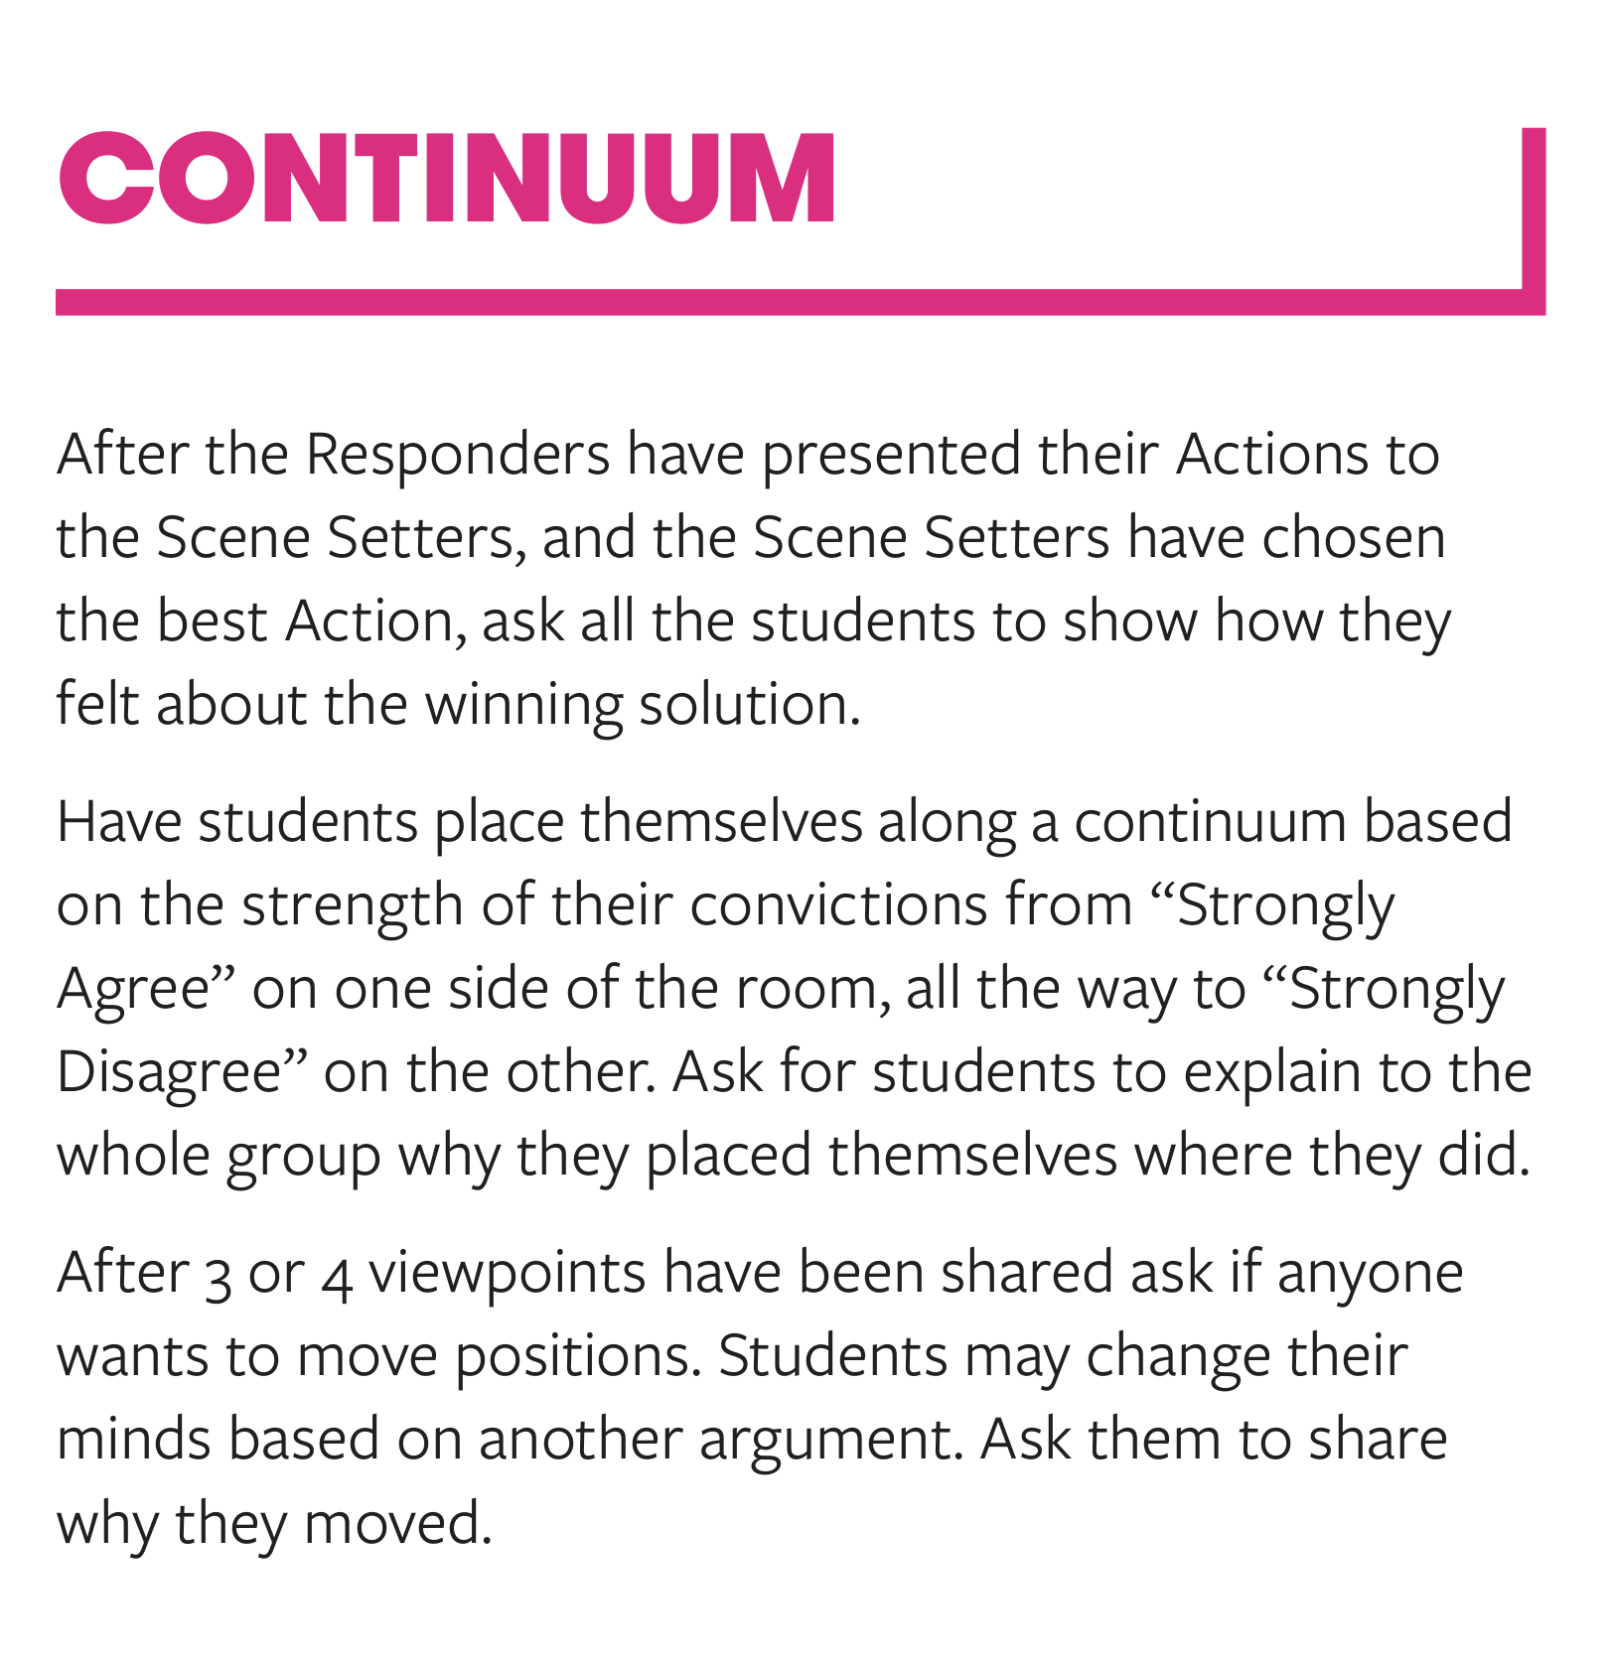
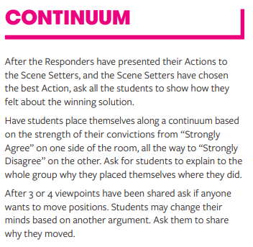
Variation

Slide 10
Useful links
This resource has nine suggestions on how to adapt PYBC for different conversations and group sizes
Order the resource here
Find more information on how to play (including a video), curriculum links, additional ways to adapt the game and evaluations here:
Guide to youth services
Notes:
More ideas can be found here: https://www.hpa.org.nz/sites/default/files/3.0%20MH131%20PYBC%20Ways%20to%20Play%20Info%20Sheet.pdf

Slide 11
Variations for health education
More information can be found here
This comprehensive resource includes up to 12 variations such as:
Feelings wheel (developing vocabulary and understanding feelings)
Making their own cards (identify wellbeing related situations relevant to their own lives and community).

